Slide 1
Phil 271 Spring 2017
Lecture 3

Slide 2
What we want to cover today
A bit of a grab-bag … to understand Kant and Mill, it will really help to have some background ideas to draw on. So a lot of this is stage setting
Prelims: some “rules of the game” for the class ...
Some “when are we doing philosophy?” discussion (this part on slides, for reference)
Arguments, inductive vs. deductive arguments, dialectic
Important concepts
Axioms, self-evidence, etc.
Necessity, possibility, contingency
Relations of ideas/matters of fact
A priori and a posteriori truths
Analytic and synthetic truths
Rationalism and Empiricism

Slide 3
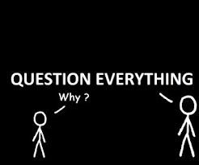
A bit about how philosophy happens …
Maybe it’s true that philosophers can be annoying, but popular culture might mislead us about what makes them annoying …
Rather than thinking of philosophy as merely holding or stating opinions on important “philosophical questions,” it’s helpful to think of philosophical inquiry as a process involving more than one participant
Remember the following slide from last week?
A misconception about philosophy

Slide 4
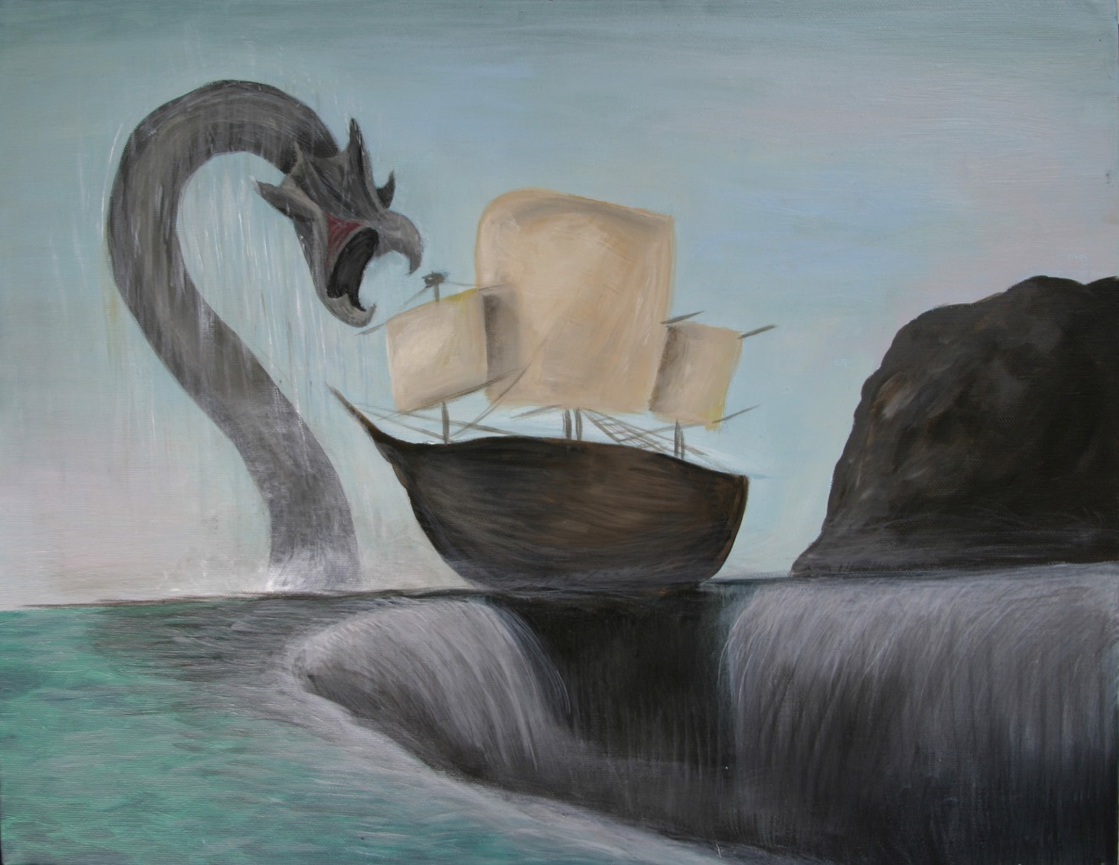
Charybdis and Scylla?
Platonism gives us good truthmakers, but sticks us with embarrassing epistemological theories
Aristotle’s views link up better with sensible ideas about how we come to know things, but seem to stick us with theories that imply that clearly true mathematical claims come out false …
Can we do better than having to say “okay, pick your poison?”

Slide 5
More than opinions
It ain’t philosophy until there is a disagreement
The disagreement often begins at the level of “intuition” or “common sense”
A “battle of intuitions” isn’t philosophy yet …
Philosophy requires presentation of reasons; philosophers are in the argument business

Slide 6
Going meta: some basic concepts of philosophy
An argument is a collection of claims, one of which is being defended (the conclusion) and the others of which are being offered as reasons (the premises)
A good argument has two important features
The premises support the conclusion---if the premises were correct, that would make it likely that the conclusion was correct too
It’s reasonable to believe the premises
In practice, many arguments include subarguments … if a premise is questionable, the arguer might offer reasons to support it.
When that happens, the conclusion of the subargument is a premise in the larger argument

Slide 7
Simple examples …
Dave is overpaid.
Therefore,
Dave should pay the bill.
An argument with one premise, where the word “therefore” indicates the conclusion.
Dave is a tenured professor.
Tenured professors in Canada make, on average, three times the average industrial wage.
So,
Dave is overpaid.
Therefore,
Dave should pay the bill.
An argument containing a subargument.

Slide 8
Two conditions for a good argument … so two ways for an argument to be bad
Bad evidence … one or more of the premises are unacceptable (i.e., it is not reasonable to believe them)
The past four Prime Ministers have been kitty cats.
Therefore,
Some recent Prime Ministers have been mammals.
Notice: this is a bad argument, even though the conclusion is true!
Lack of support … even if the premises were true, that would not give much reason to believe the conclusion.
Dave is a professional philosopher
Therefore,
Dave is fearless and decisive
Notice: the premise is true, but the argument is still bad … We don’t have the right kind of connection between the premise and the conclusion.
Note also: an argument that is bad this way might have both a true conclusion and all of its premises true, too

Slide 9
Going meta: rudiments of philosophical method
Steps involved in evaluating a philosophical view
Set out the argument explicitly (“in standard form”, i.e., make clear what the premises are, and what the conclusion is, subargument structure if any …)
Evaluate the premises: for each, ask: is this claim a reasonable one to believe?
Evaluate how strong the support is that the premises provide for the conclusion
Criticism of the argument will normally take the form of giving reasons for saying no in 2 or answering not very much in 3

Slide 10
Why do philosophers seem to be “off topic” so often?
Note that a critic of a philosophical argument is providing an argument … but not directly about the original subject matter. Instead it’s an argument designed to show that the original argument is not cogent, for instance an argument that a premise is unacceptable.
If someone attacks my argument this way, how can I respond?
Throw in the towel … a less preferred option, usually.
Show that the critic is mistaken … by attacking her argument! So, either by showing that she’s relying on a faulty premise or that her reasoning is faulty

Slide 11
Why do philosophers seem to be “off topic” so often
This process of argument, counter-argument, counter-counter argument, and so on, is sometimes called the dialectical process.
Notice how quickly it can lead from a particular topic to a discussion of something we probably didn’t have in mind to start with:
Plato: I have a theory … I call it the theory of the forms, and it explains what makes mathematical claims true …
Critic: Your theory makes it mysterious how we can know the things we do know about mathematics.
Defender of Plato: It’s not really a mystery. Humans have a faculty of “mathematical intuition” that is like the physical senses, but allows us to perceive things in “Plato’s heaven”
Critic: Unlike the physical senses, we have no way to corroborate what this supposed faculty tells us … we can’t double-check to see whether we’re “seeing clearly” or are in the grip of an illusion …
Notice: In no time we’re involved in a discussion of how to tell illusory from veridical perception. We didn’t start there! But it’s a crucial part of this defence of the theory of forms, where we did start.

Slide 12
How strong?
The first condition for being a good argument:
The premises support the conclusion---if the premises were correct, that would make it likely that the conclusion was correct too
This obviously comes in degrees. This leads us to an important distinction in philosophy …
An argument is deductively valid when the truth of the premises would guarantee the truth of the conclusion.
An argument in which the premises support the conclusion but that is not deductively valid is said to be inductively strong.

Slide 13
Examples
Deductively valid:
Dave is an adult male.
Therefore,
Dave is an adult.
Inductively strong:
Dave is a philosopher.
Therefore,
Dave reads a lot of books.
In an inductively strong argument, it is possible for all the premises to be true and the conclusion false, but it is unlikely.

Slide 14
There are different kinds of inductive argument: here are two important ones
Enumerative induction:
Conclude on the basis of observed cases that unobserved cases will be similar.
Dave is a philosopher, and he’s boring.
Jill is a philosopher, and she’s boring.
[many other instances … ]
Therefore,
All philosophers are boring.
Inference to the best explanation:
Notice that if something were true, it would explain something we know to be true and that it is better than other explanations of that truth, so infer that it the explanation is probably correct.
I hear scratching in the walls at night.
What looks like caraway seeds have started appearing along the baseboards.
Therefore,
Mice have moved into my house.

Slide 15
Postulates and Common Notions
Common notions:
Things which are equal to the same thing are also equal to one another.
If equals are added to equals, the whole are equal.
If equals be subtracted from equals, the remainders are equal.
Things which coincide with one another are equal to one another.
The whole is greater than the part.
Postulates:
A straight line segment can be drawn connecting any two points
Any straight line segment can be extended indefinitely in a straight line.
Given any straight line segment, a circle can be drawn having the segment as radius and one endpoint as center.
That all right angles are congruent.
If two lines are drawn which intersect a third in such a way that the sum of the inner angles on one side is less than two right angles, then the two lines inevitably must intersect each other on that side if extended far enough.

Slide 16
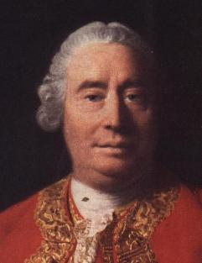
A strong claim … in disguise as a distinction
All the objects of human reason or enquiry may naturally be divided into two kinds, to wit, relations of ideas, and matters of fact. Of the first kind are the sciences of geometry, algebra, and arithmetic, and in short, every affirmation which is either intuitively or demonstratively certain. …
Propositions of this kind are discoverable by the mere operation of thought, without dependence on what is anywhere existent in the universe.
Matters of fact, which are the second objects of human reason, are not ascertained in the same manner; nor is our evidence of their truth, however great, of a like nature with the foregoing. The contrary of every matter of fact is still possible, because it can never imply a contradiction, and is conceived by the mind with the same facility and distinctness, as if ever so conformable to reality.
David Hume, 1772

